Slide 1

Lab 1 : ER Diagram
By NAJI Adam, MOUJAHID Souhayl, KHRISS Ahmad and MOUHRI Ilyas

Slide 2
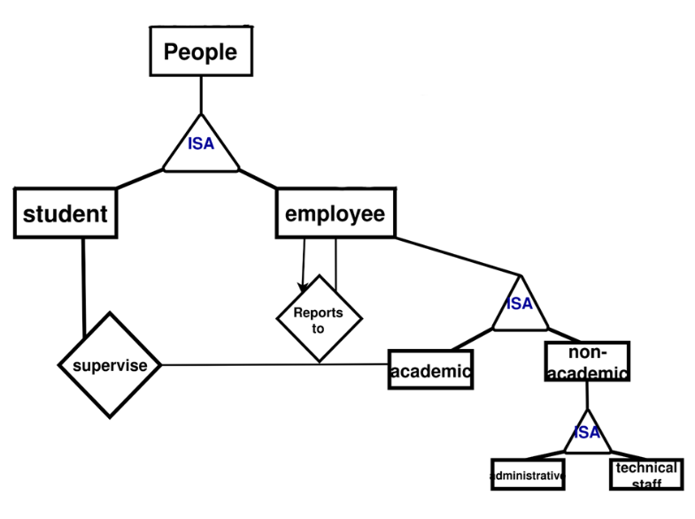
Project Code
code
Research Project
holds
certification
supplier
int_id
Attached
supplies
require
is involved
lab_id
Supervises
Faculty
consumables
paired
Laboratories
model_id
id
Equip_Units
Corresponds
Equip_Model
Host
serial_num
ISA
Calibration
date
tracks
calibrating
Fixed_Units
Calibration record
Mobile_Units
maintained
operated
Maintenance Operation
maintenance
start

Slide 3
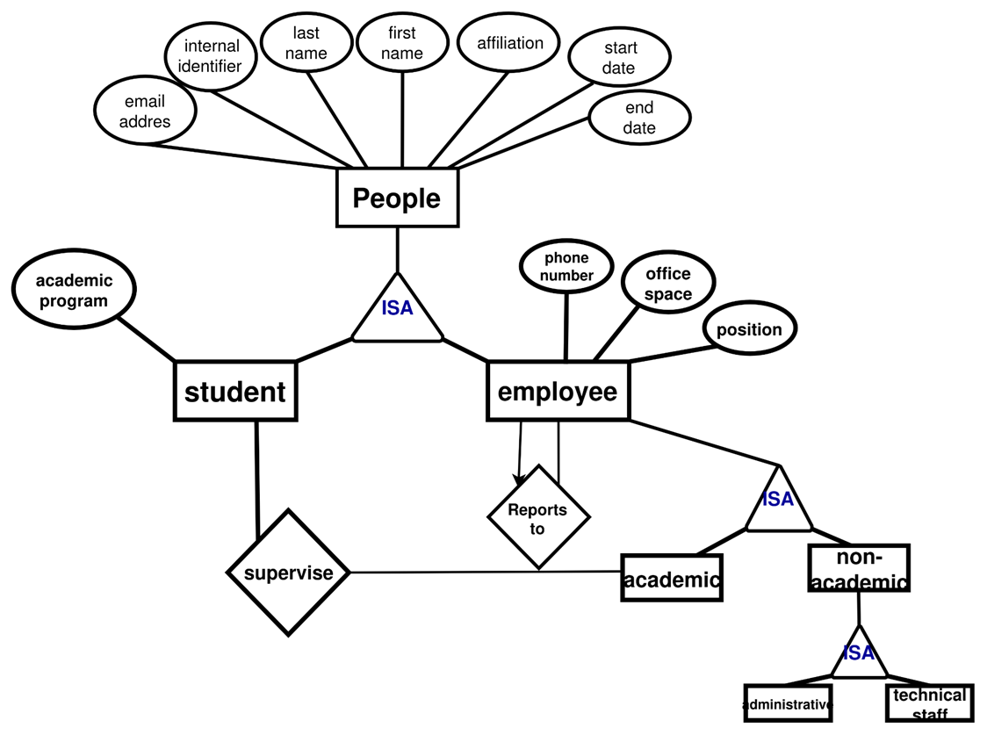
/ People

Slide 5
/ Laboratories
name
room_num
lab_id
building
rsrch_area
People
Laboratories
Faculty
Attached
Supervises
Host
Fixed_Units
Mobile_Units

Slide 6
Attached
Laboratories
Supervises
Faculty
Host
Fixed_Units
Mobile_Units

Slide 7
/Equipement Units & Model
serial_num
acqu_date
cost
Equip_Units
opp_status
lab
ISA
Corresponds
spcl_training
model_id
Equip_Model
Fixed_Units
Mobile_Units
req_env
category
cname

Slide 8
Attached
Laboratories
Supervises
Faculty
Equip_Units
Host
Corresponds
ISA
Equip_Model
Fixed_Units
Mobile_Units

Slide 9
/Certifications and Authorizations
code
title
issuing authority
validity period
safety level
equipment
require
certification
issue date
end date
holds
result
person

Slide 10
Attached
Laboratories
Supervises
Faculty
Equip_Units
Host
Corresponds
ISA
Equip_Model
Fixed_Units
Mobile_Units
require
holds
certification

Slide 11
/Research project
Project Code
Research Project
is involved
People
Role

Slide 12
Research Project
is involved
Attached
Laboratories
Supervises
Faculty
Equip_Units
Host
Corresponds
ISA
Equip_Model
Fixed_Units
Mobile_Units

Slide 13
/ Calibration Record
Calibration
date
Calibration record
calibrating
Equipment Unit

Slide 14
/Consumables
unit of measure
hazard level
name
quantity
id
reord_thr
quantity
consumables
uses
reservation
restock date
pair
price
storage condition
laboratory
supplies
supplier
assignment date
tracks
technical staff member

Slide 15
Research Project
is involved
Attached
Laboratories
Supervises
Faculty
Equip_Units
Corresponds
Equip_Model
Host
ISA
calibrating
Calibration record
Fixed_Units
Mobile_Units

Slide 16
/ Maintenance Operation
maintenance
start
Technical Staff
operated
Maintenance Operation
maintained
Equipment Unit

Slide 17
Project Code
code
Research Project
holds
certification
supplier
int_id
Attached
supplies
require
is involved
lab_id
Supervises
Faculty
consumables
paired
Laboratories
model_id
id
Equip_Units
Corresponds
Equip_Model
Host
serial_num
ISA
Calibration
date
tracks
calibrating
Fixed_Units
Calibration record
Mobile_Units
maintained
operated
Maintenance Operation
maintenance
start

